Slide 1
PRIME FITNESS
WORK HARDER, GET STRONGER
EASY WITH OUR GYM

Slide 2
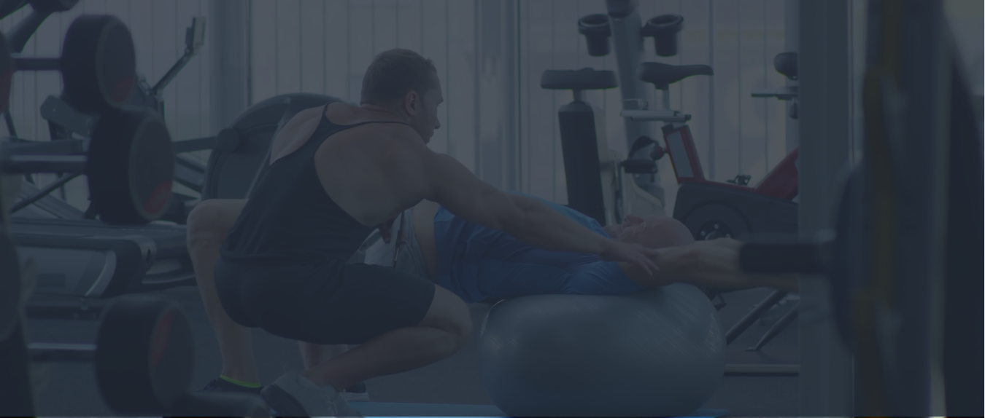
OUR TEAM
Faculty Name | Sir Kousar, Miss Esha
Group | Prime Fitness
Team Members | 04
S.no | Name | Id | Phone No
1 | Rida Eman Asghar | Student 1335013 | Phone: 0332-2800726
2 | Insiyah yosuf ali | Student 1335013 | Phone: 0332-2800726
3 | Saim Sachwany | Student 1335013 | Phone: 0332-2800726
4 | Ebad | Student 1335013 | Phone: 0332-2800726

Slide 3
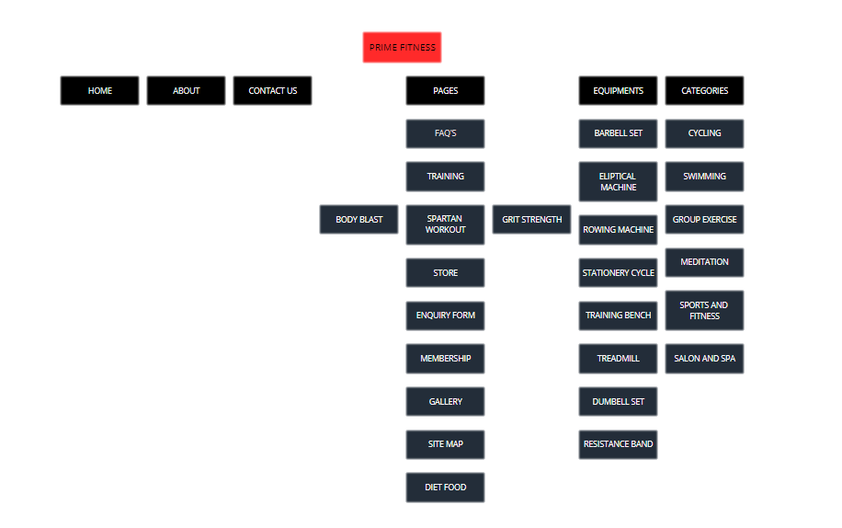

Slide 4
PRIME FITNESS
PRIME is owned and operated by Specialty Fitness Systems (SFS), based in Northwestern PA. After forming in early 2014, SFS acquired STRIVE Strength, and their patented STRIVE adjustable cam technology. There's a whole library of free workout videos available to Amazon Prime Members. If you go to Amazon Prime Video, you can find a number of workouts that vary in length from five minutes to an hour.

Slide 5
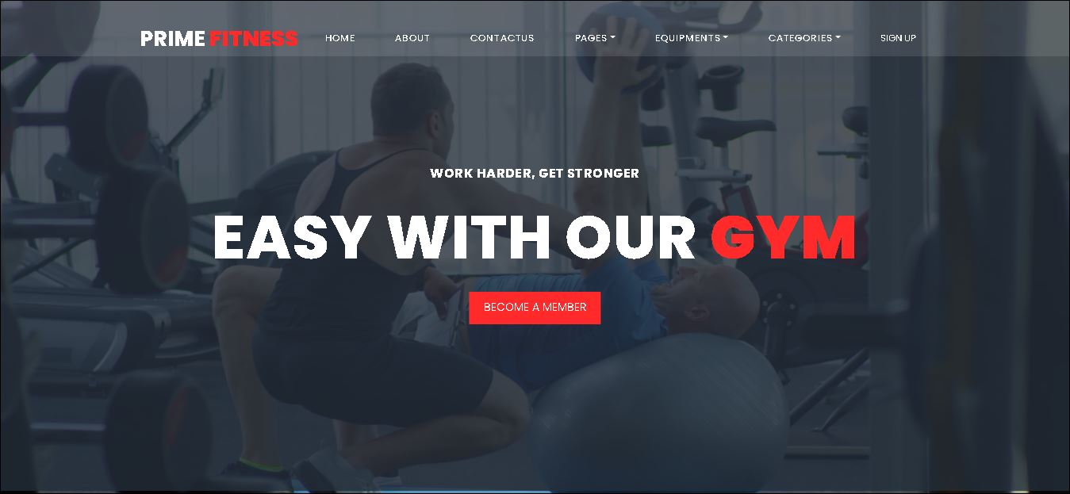
Header
Our Header:

Slide 6
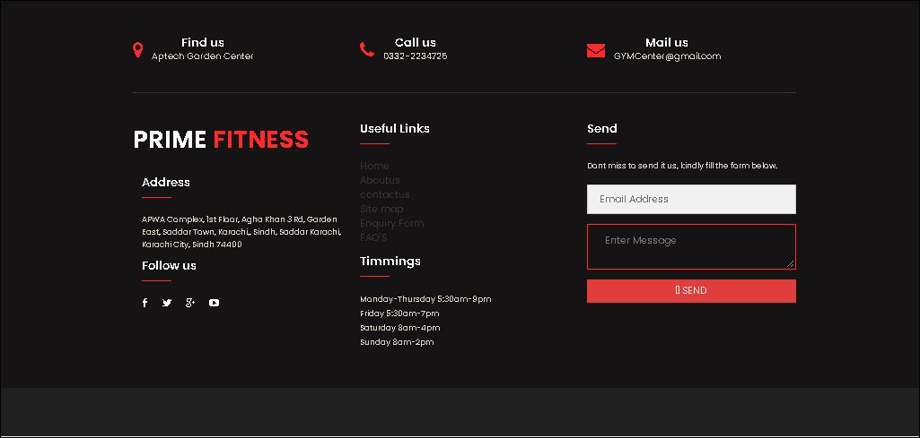
Footer
Our Footer:

Slide 7
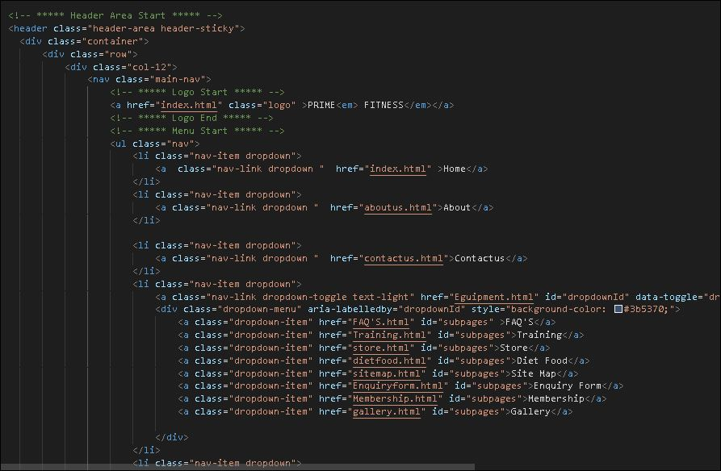
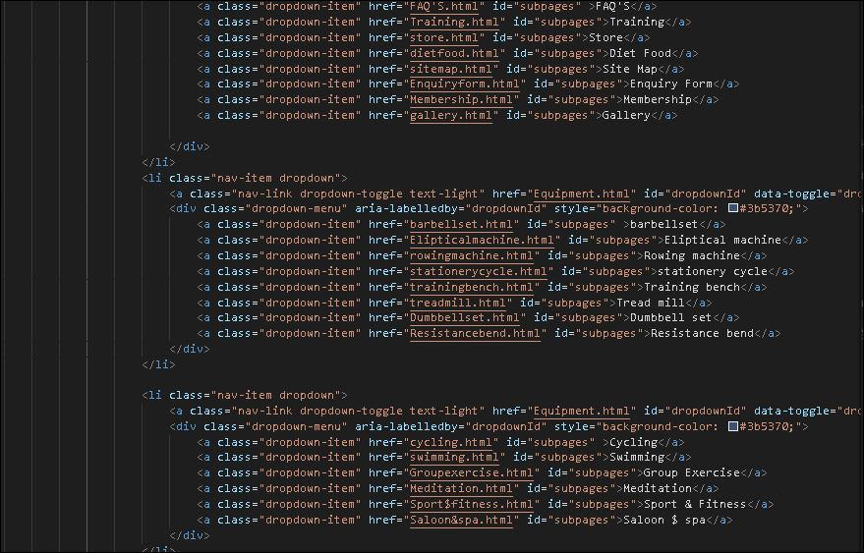
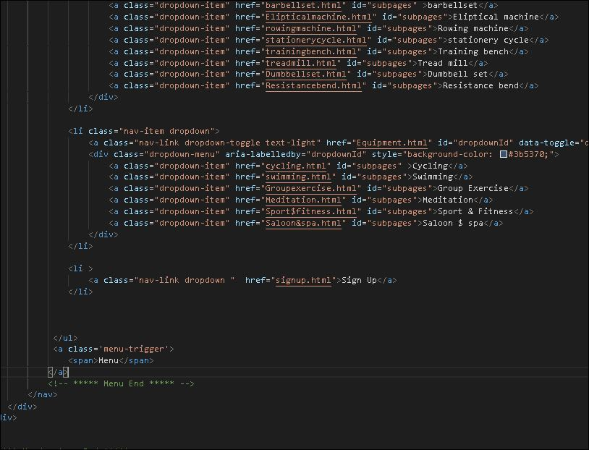
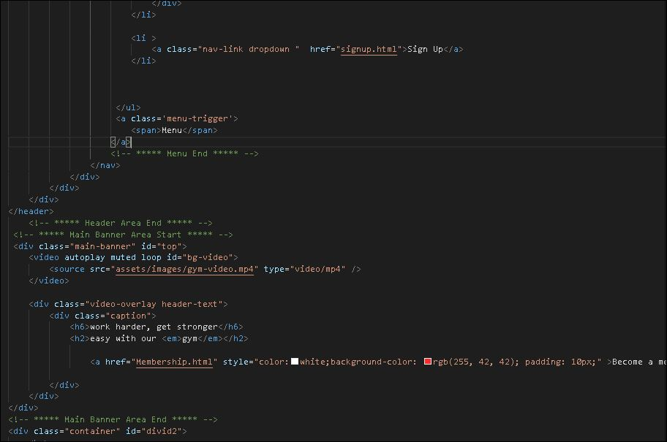
Codes
Header codes:

Slide 8
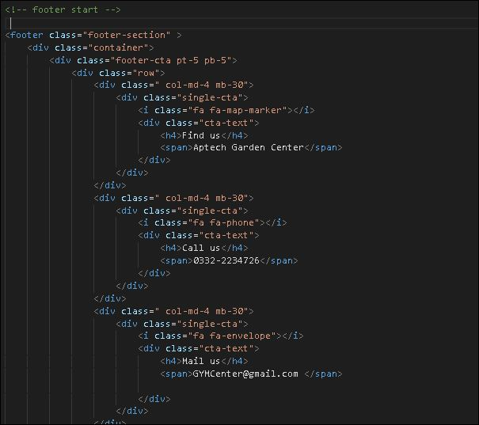
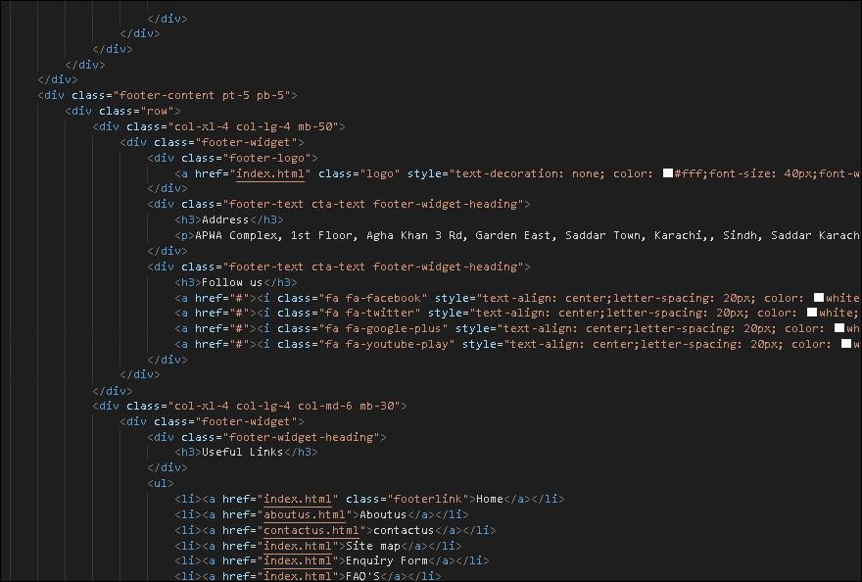
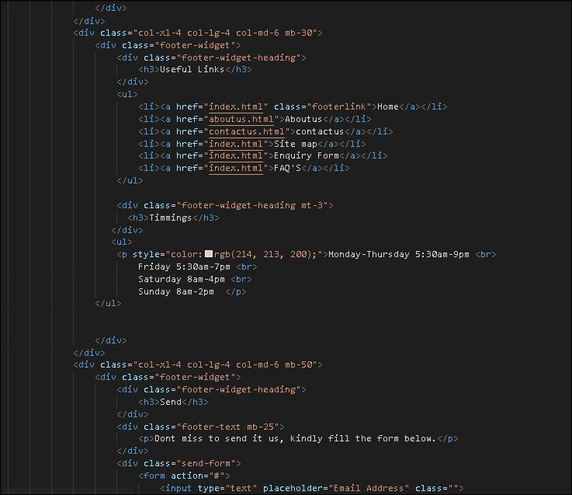
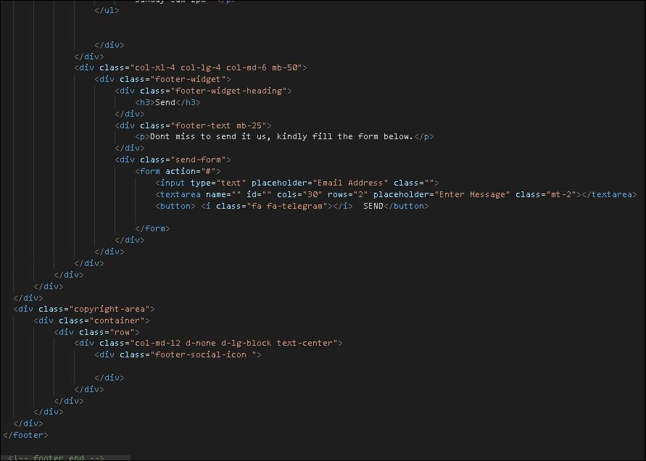
Codes
Footer codes:

Slide 9
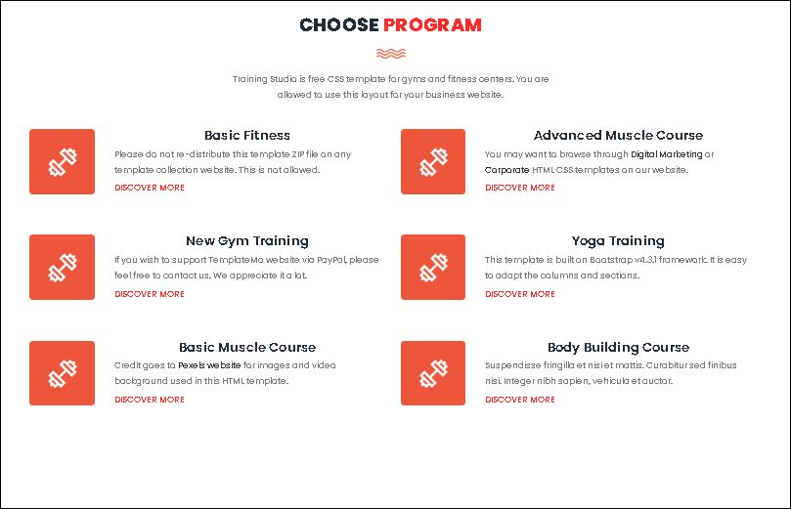
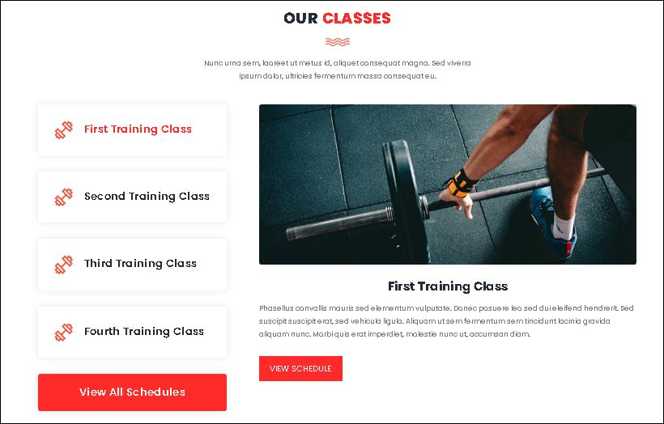
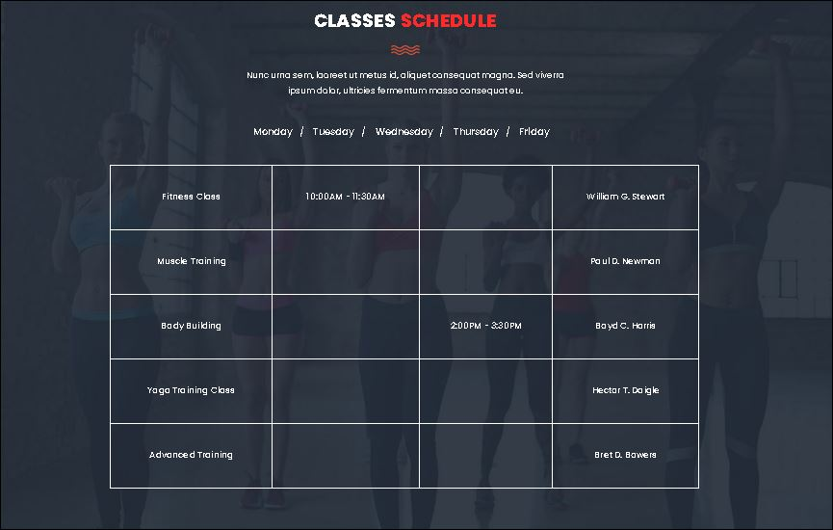
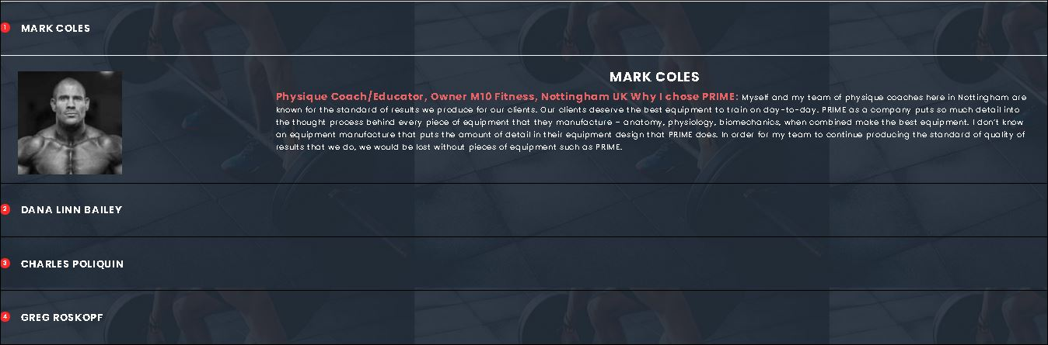
Pictures
Home Snips:

Slide 10
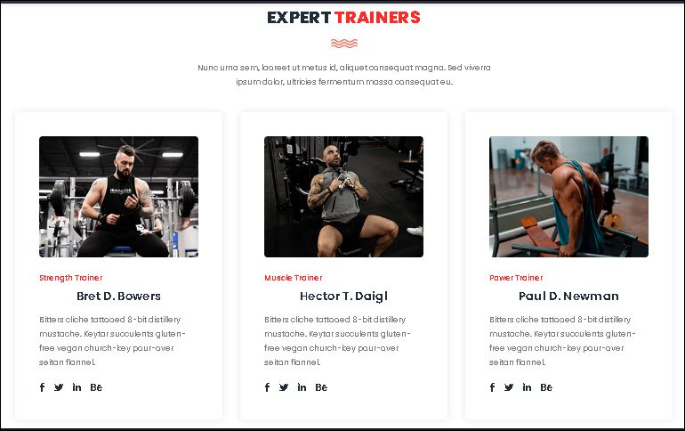
Pictures
Our trainers:

Slide 11
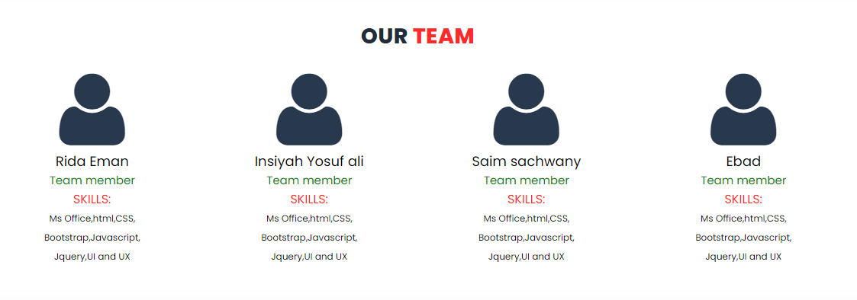
Pictures
Our Team Detail:

Slide 12
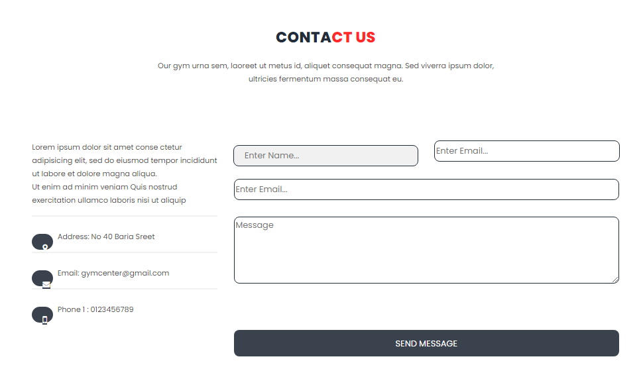
Pictures
Our Contact us:

Slide 13
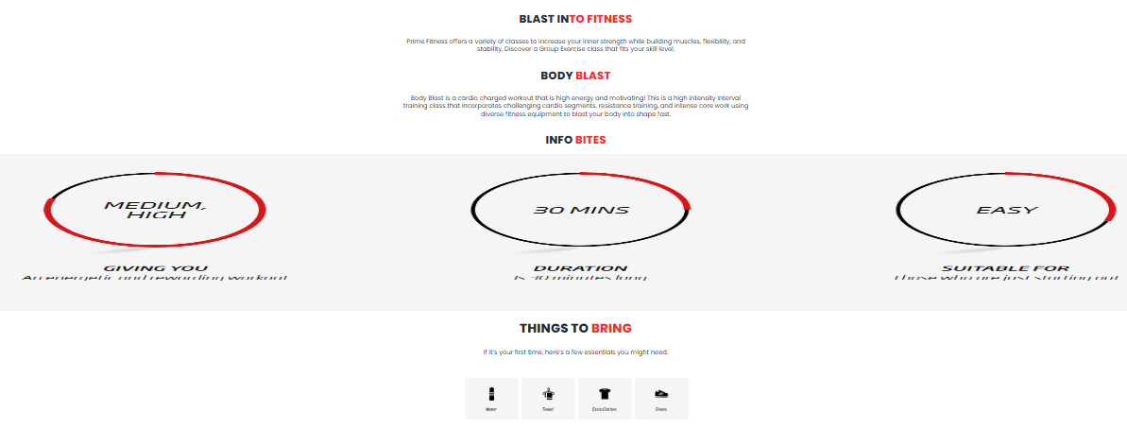
Pictures
Training:

Slide 14
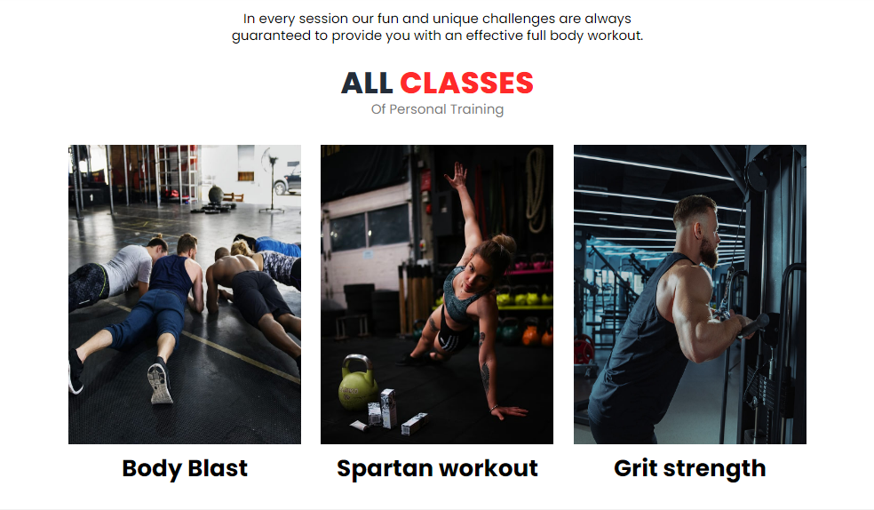
Pictures
Training:

Slide 15
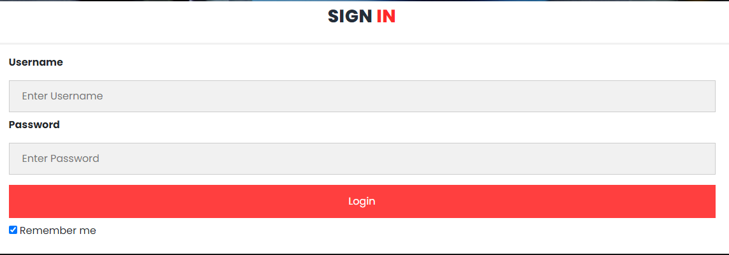
SIGN IN
Sign In Form:

Slide 16
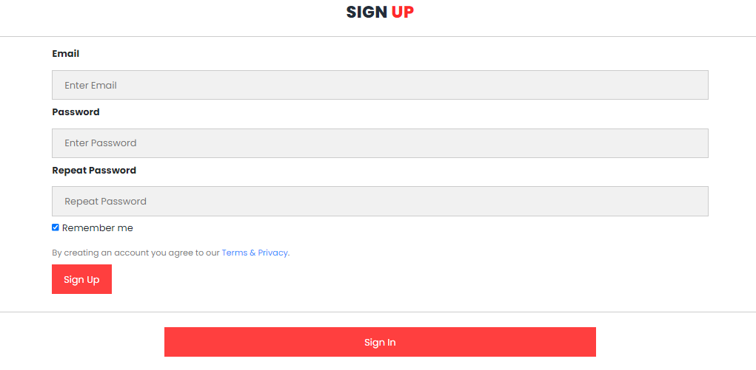
SIGN UP
Sign Up Form:

Slide 17
THANKS FOR WATCHING

